Slide 1
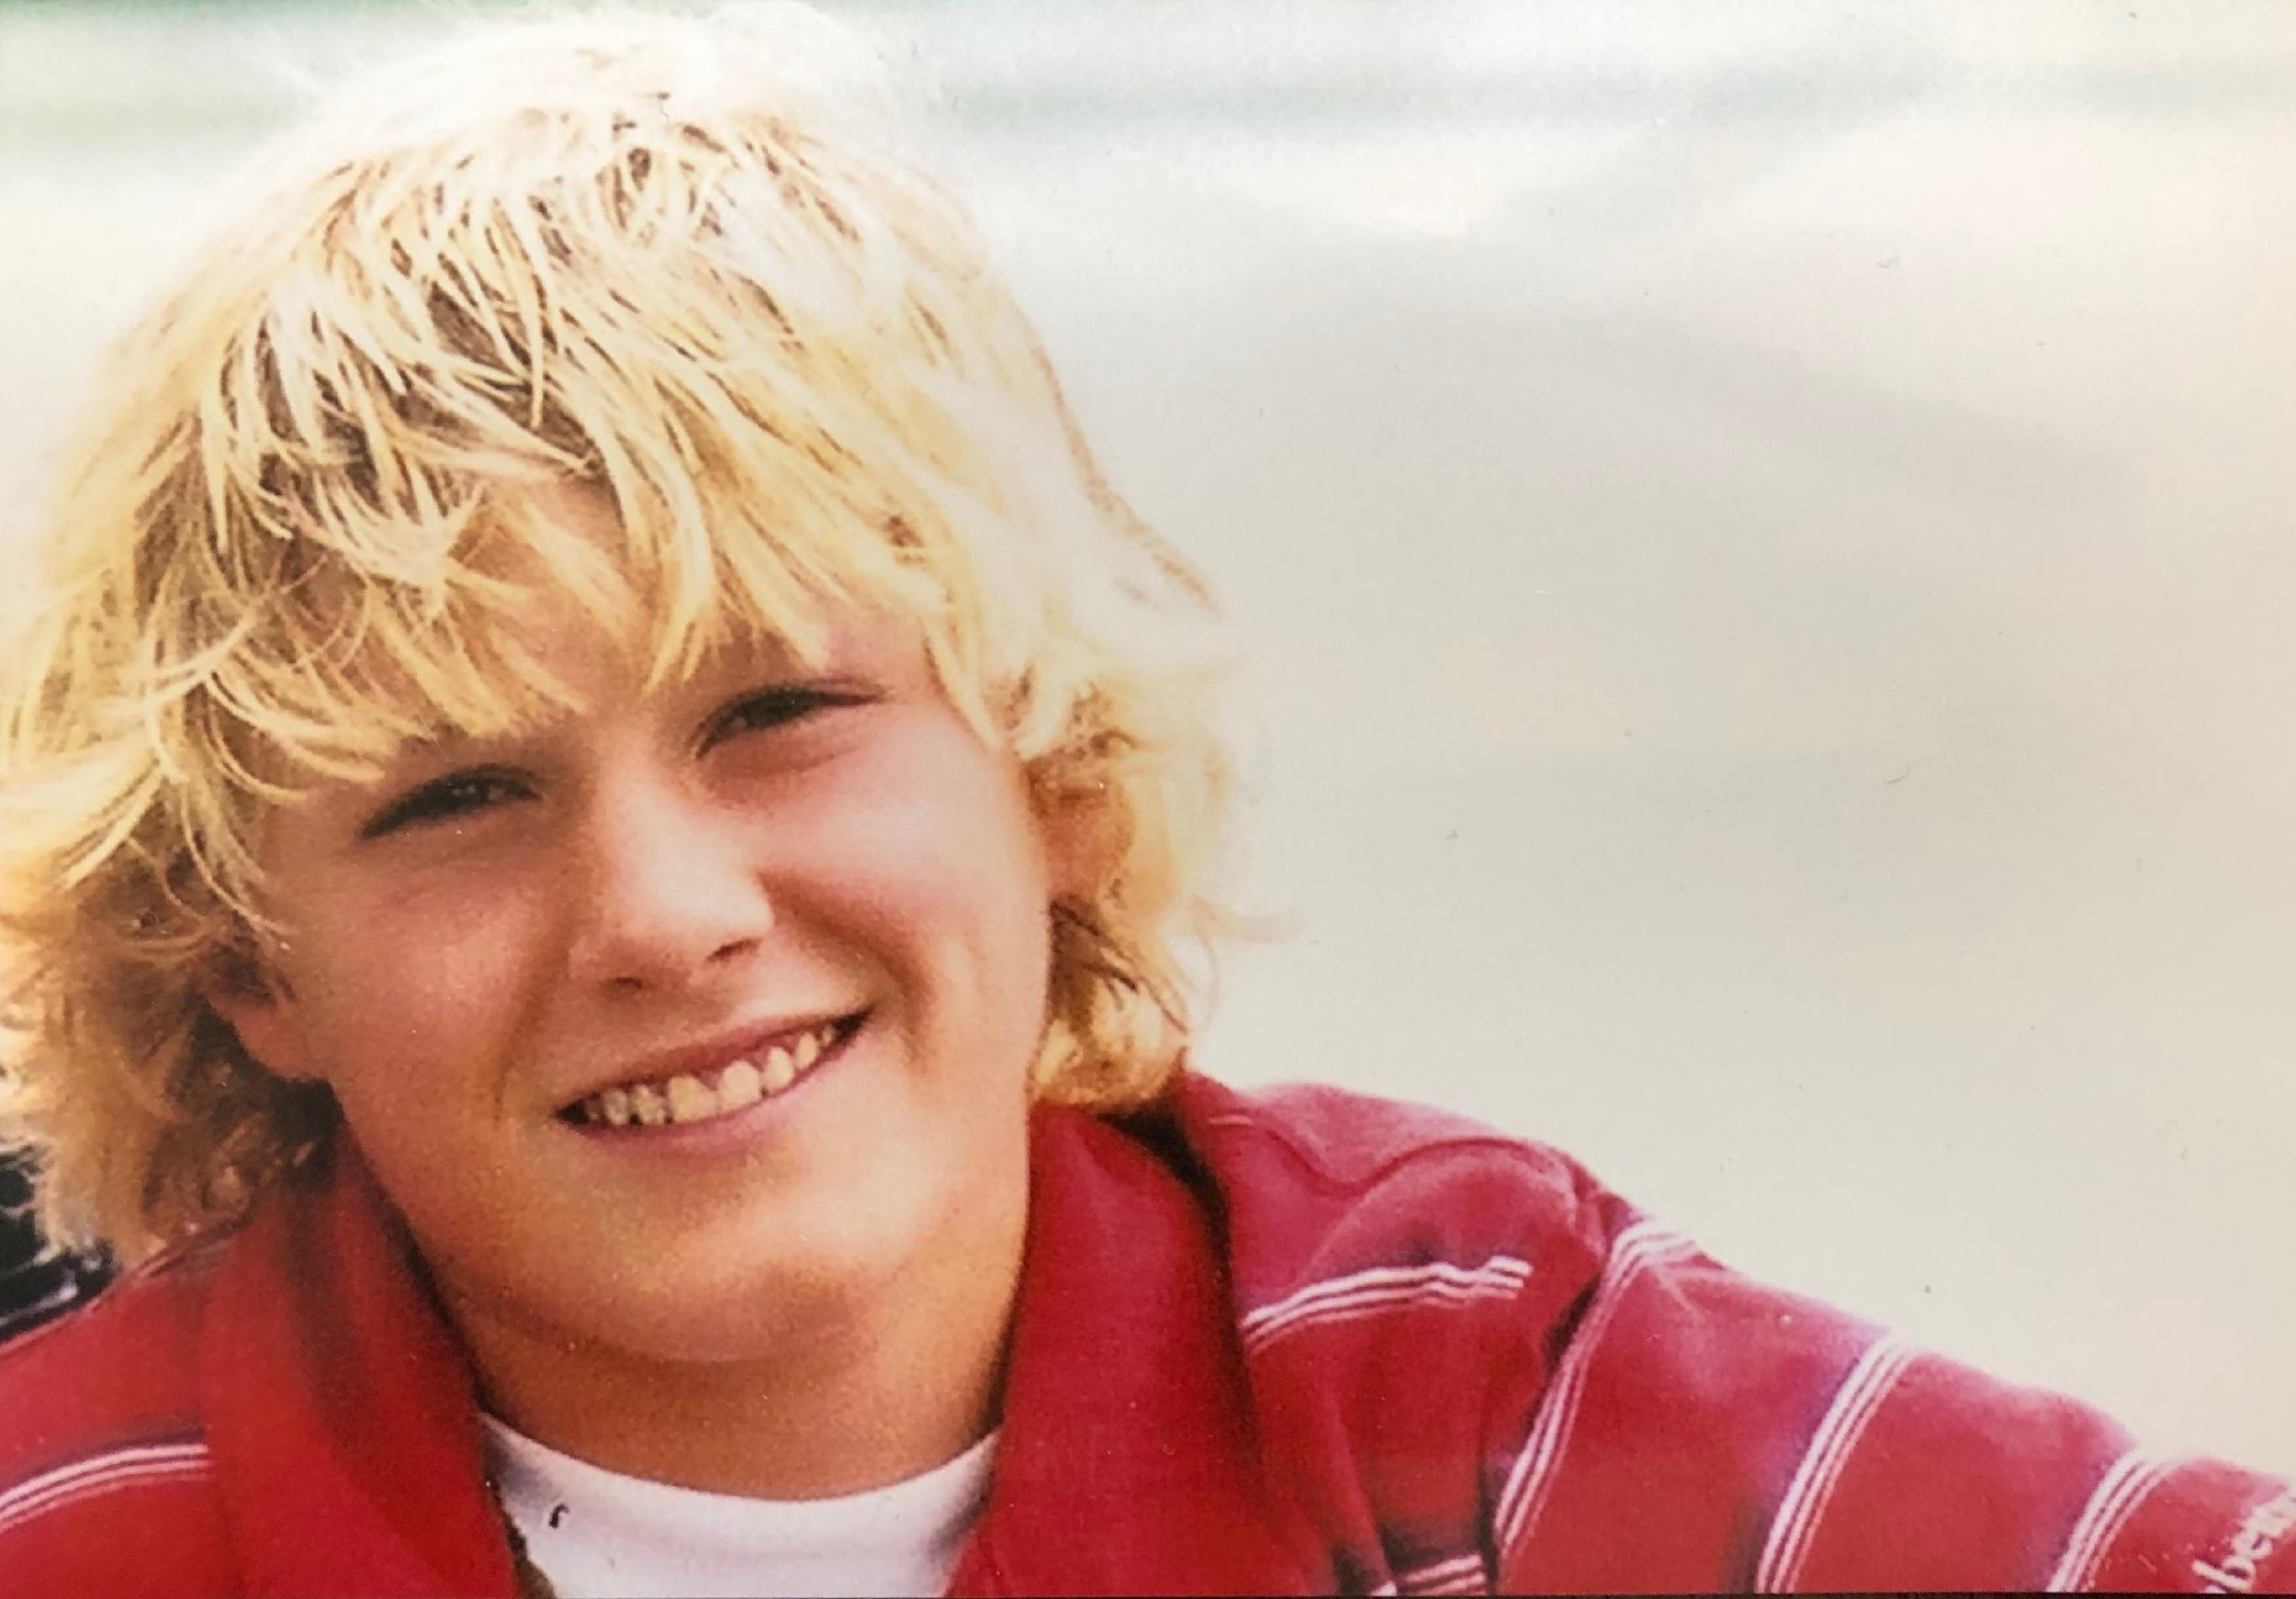
TANNER KITELINGER MEMORIAL
RISING STAR AWARD

Slide 2
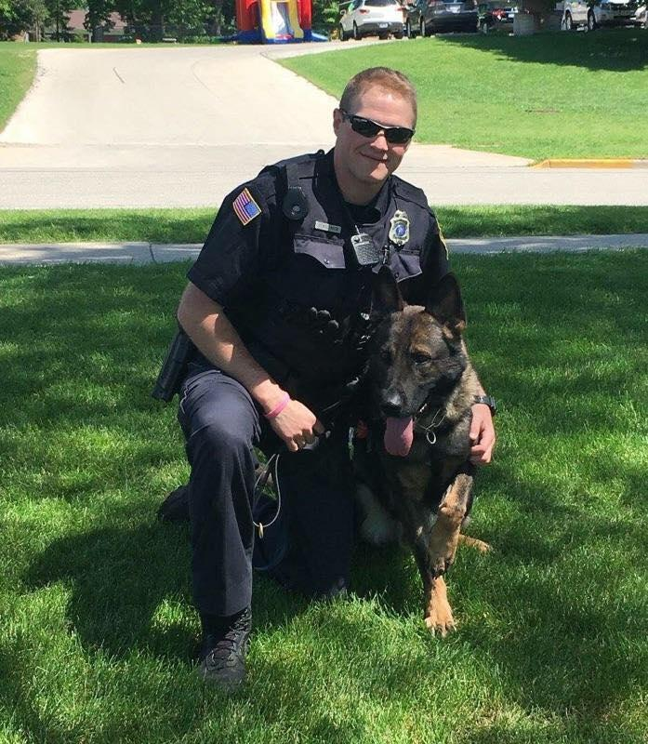
On June 9th, 2017, the world lost a selfless, kind, and thoughtful son, grandson, brother, nephew, cousin, and best friend when Tanner Kitelinger tragically passed away from complications of Type 1 Diabetes.
Tanner could comfort and light up a room with his warm and compassionate personality and contagious smile. He formed special connections with everyone he met, because of his genuine kindness and sense of humor. After learning of his passing, Tanner’s friends stated; “He was truly one of a kind” and “To know Tanner, was to love Tanner.” Tanner’s life and legacy continue to inspire countless members of his family, friends, and the community.
We are beyond devastated that our TanMan is gone, but we are beyond proud of who he was.

Slide 3
THE AWARD
Tanner attended Beloit Turner from Kindergarten through 8th grade, and Beloit Memorial from Freshman year though graduation in June 2008. Tanner then went on to graduate from the University of Wisconsin Whitewater with a Bachelor of Business Administration degree in May 2012.
After seeing the other side of the businesses world, Tanner decided to follow his path and dream to serve and protect, and graduated President of his class at Blackhawk Technical College Law Enforcement Recruit Academy. Following graduation, Tanner signed on with the Burlington, WI. Police Department. After a year and half on patrol, Tanner re-launched the Burlington, WI Police Department K9 program and added his K9 partner, Zander. They were a team on patrol until the day Tanner succumbed to complications of Type 1 Diabetes.
This award has been created in honor of Tanner Kitelinger, "A Rising Star”’s, memory and legacy of bringing good to all those around him.

Slide 4
CRITERIA &
REQUIREMENTS
CRITERIA:
Must be a graduating senior of Beloit Turner or Beloit Memorial High Schools.
Must be a resident of Rock County.
Must be pursuing higher level education as a first responder or front line worker.
REQUIREMENTS:
Tanner was motivated to become a police officer to help others. He was a kind & compassionate person who treated everyone with respect.
Generate an essay telling us:
What has inspired you to want to become a First Responder or Front Line worker who professionally protects & serves his community.
The ways you have helped others in your school and community & brought good to those around you (be specific).

Slide 5
REVIEW PROCESS
& ALLOCATION
REVIEW:
Essays will be reviewed by the Administrators, Family, & Founders Committee of the Tanner Kitelinger Memorial Fund
AWARD:
2-$2500.00 awards to a graduating senior in good standing at Beloit Turner High School continuing their education.
2-$2500.00 awards to a graduating senior in good standing at Beloit Memorial High School continuing their education.
If, in any academic year, there is no applications from one of the schools or not two as offered, its possible more that two awards could be awarded to the other school by default, if they are qualified.

Slide 6
2024 AWARD MILESTONES
Activity | Timing
Criteria & Essay Submission Details sent to Beloit Turner & Beloit Memorial teachers, guidance counselors, & administration for distribution & nominations | 01/31/24
Essay Submission deadline | 03/15/24
Committee Review of all Essays | 3/15/24 – 4/15/24
Award Winners alerted via phone/email | 5/1/24

Slide 7
FOR ANY QUESTIONS PLEASE CONTACT
TANNERKITELINGERAWARD@YAHOO.COM

